Slide 1
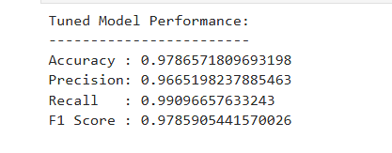
Generous Tipper Prediction — Machine Learning Model Outcomes
Executive Summary for the New York City Taxi and Limousine Commission
Automatidata developed a machine learning model to accurately predict whether a NYC taxi rider will leave a generous tip (≥20%). The goal is to support driver earnings planning and operational decision-making.
The original objective of predicting non-tippers was reconsidered due to fairness concerns. The team instead focused on predicting generous tippers to avoid potential ethical issues and ensure equitable treatment of passengers.
A Random Forest model was tuned using GridSearchCV, achieving exceptional performance with an F1 score of 0.9786. This far exceeds previous benchmarks and provides reliable predictions for real-world use.
Behind the Data
The team engineered key features such as trip duration (minutes), tip percentage, pickup hour/day/month, and calculated the target variable (generous_tip). Payment type, total fare, and surcharges emerged as the strongest predictors.
F1 scores for random forest model
Future Model Suggestions
• Collect more granular rider and trip context data.
• Incorporate clustering to identify high-tipping zones.
• Add anomaly detection for unusual tipping behaviors.
Results Summary:
The tuned model achieved: Accuracy 97.87%, Precision 96.65%, Recall 99.09%, and F1 Score 97.86%. Predictions are highly reliable, with only 20 false negatives and 76 false positives out of 4,498 rides.
Next Steps
• Integrate the model into TLC operational dashboards.
• Explore weather, traffic, and driver-level behavioral features.
• Deploy real-time prediction tools to enhance fleet operations.

